Slide 1

BLOOD BANK DONATION SYSTEM CSA4309:INTERNET PROGRAMMING FOR WEB SERVICES
Project Supervisor
Dr. Jayasakthi Velmurugan K
Department of Deep Learning
Saveetha School of Engineering,
SIMATS
Presented By
A. Narendra Kumar Reddy- 192211960
P. Bhanu Muralidhar Reddy- 192211961
S. Harshavardhan Reddy- 192210309
Saveetha School of Engineering,
SIMATS

Slide 2
LIST OF CONTENTS
S. No | Content
1 | INTRODUCTION
2 | OBJECTIVES
3 | EXISTING SYSTEM & DRAWBACKS
4 | PROPOSE SYSTEM
5 | BLOCK DIAGRAM
6 | TECHNIQUES USED
7 | MODULES
8 | CONCLUSION & FUTURE ENHANCEMENTS
9 | REFERENCES

Slide 3

Introduction
Blood banks play a vital role in healthcare by ensuring a safe and readily available supply of blood for patients in need.
1
Blood Safety
2
Supply Chain Management
Blood banks must maintain strict quality control and safety standards throughout the entire blood management process.
Efficient blood collection, storage, and distribution are essential to meet the diverse needs of hospitals and patients.
3
Donor Management
4
Inventory Management
Effective donor recruitment and retention are crucial for ensuring a steady supply of blood.
Accurate tracking and management of blood inventory is essential for optimal utilization and minimizing waste.

Slide 4

Objectives
The primary aim is to develop a modern and robust blood bank system that streamlines operations and enhances blood management efficiency.
Objectives
Benefits
Automate blood donation and inventory management processes.
Increased efficiency and reduced operational costs.
Improved blood safety and patient care.
Improve donor management and recruitment.
Enhanced donor satisfaction.
Enhance blood safety and quality control.
Better data insights for informed decision-making.
Streamline blood distribution and logistics.
Provide real-time data analytics for informed decision-making.

Slide 5

Existing System & Drawbacks
Many blood banks rely on outdated manual systems that are prone to errors, inefficiencies, and limited data analysis capabilities.
Drawbacks
Impact
Manual record keeping
Errors, inconsistencies, and difficulty in accessing data.
Paper-based processes
Time-consuming, prone to loss or damage, and inefficient workflow.
Limited data analysis
Inability to gain insights into blood supply trends, donor behavior, and operational efficiency.

Slide 6
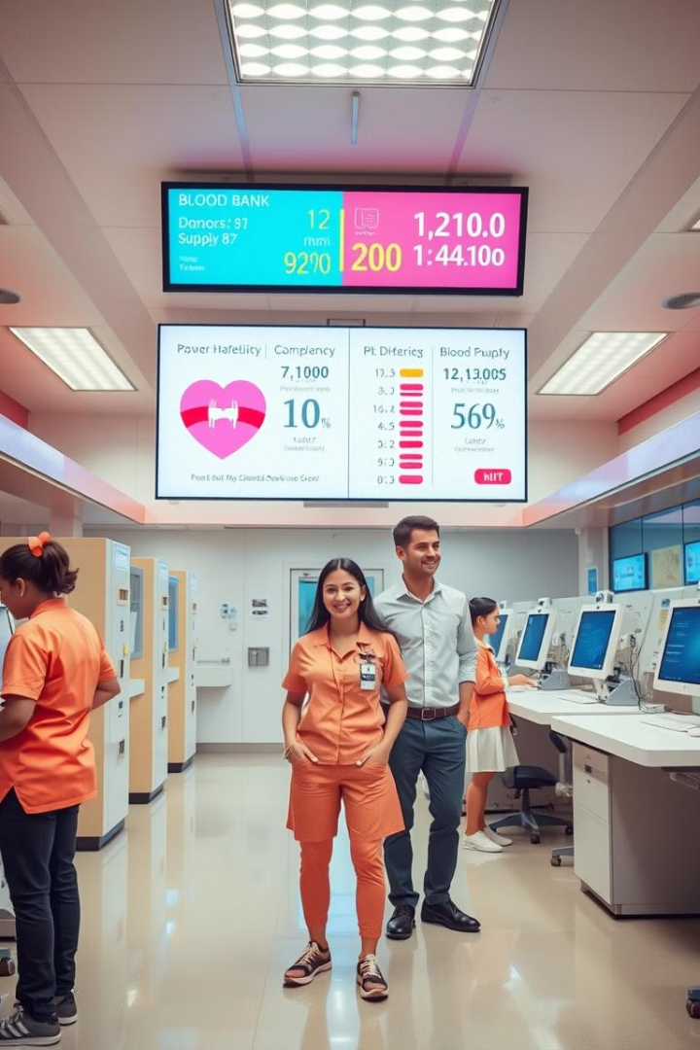
Propose System
The proposed system leverages advanced technologies to address the shortcomings of the existing system and improve overall blood bank operations.
Centralized Database
Automated Processes
A secure and centralized database will store all blood-related information, ensuring data integrity and accessibility.
Automating tasks like blood donation registration, inventory management, and blood component separation will improve efficiency and accuracy.
Real-Time Tracking
Real-time tracking of blood units, from collection to distribution, provides transparency and enables timely decision-making.

Slide 7
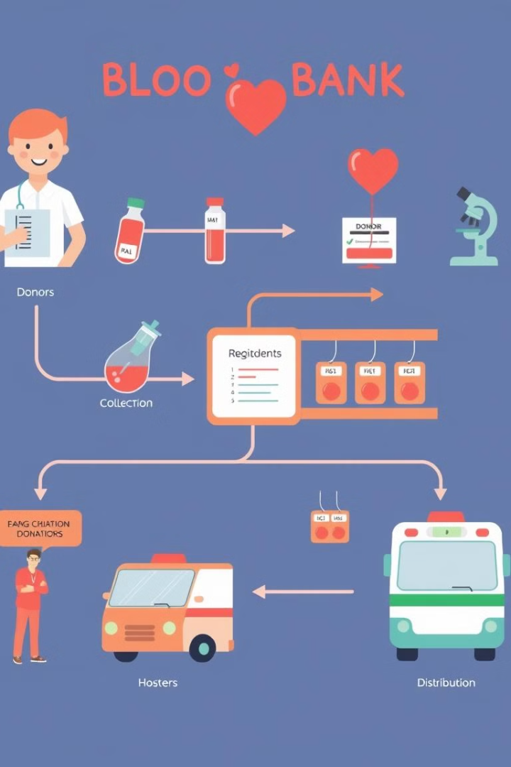




Block Diagram
The proposed system consists of several interconnected modules, each performing specific functions to ensure efficient blood management.
Donor Management
Captures donor information, manages appointments, and tracks donation history.
Inventory Management
Tracks blood units, components, and their availability for distribution.
Blood Testing
Manages blood testing procedures, recording results and ensuring blood safety.
Distribution and Logistics
Handles blood requests, prioritizes distribution based on urgency, and manages transportation.

Slide 8

Techniques Used
The development of the system utilizes modern technologies and best practices to ensure its effectiveness and robustness.
Front-end
Frontend development is how to create a website's user interface visually and in terms of interactivity. It means web development enabling Execute Web Design using coding languages such as HTML, CSS, and JavaScript.
Back-end
The back end is a combination of servers and databases. Servers control how users access files. Databases are organized and structured collections of data.
Security Measures
Robust security measures are implemented to protect sensitive donor data.

Slide 9
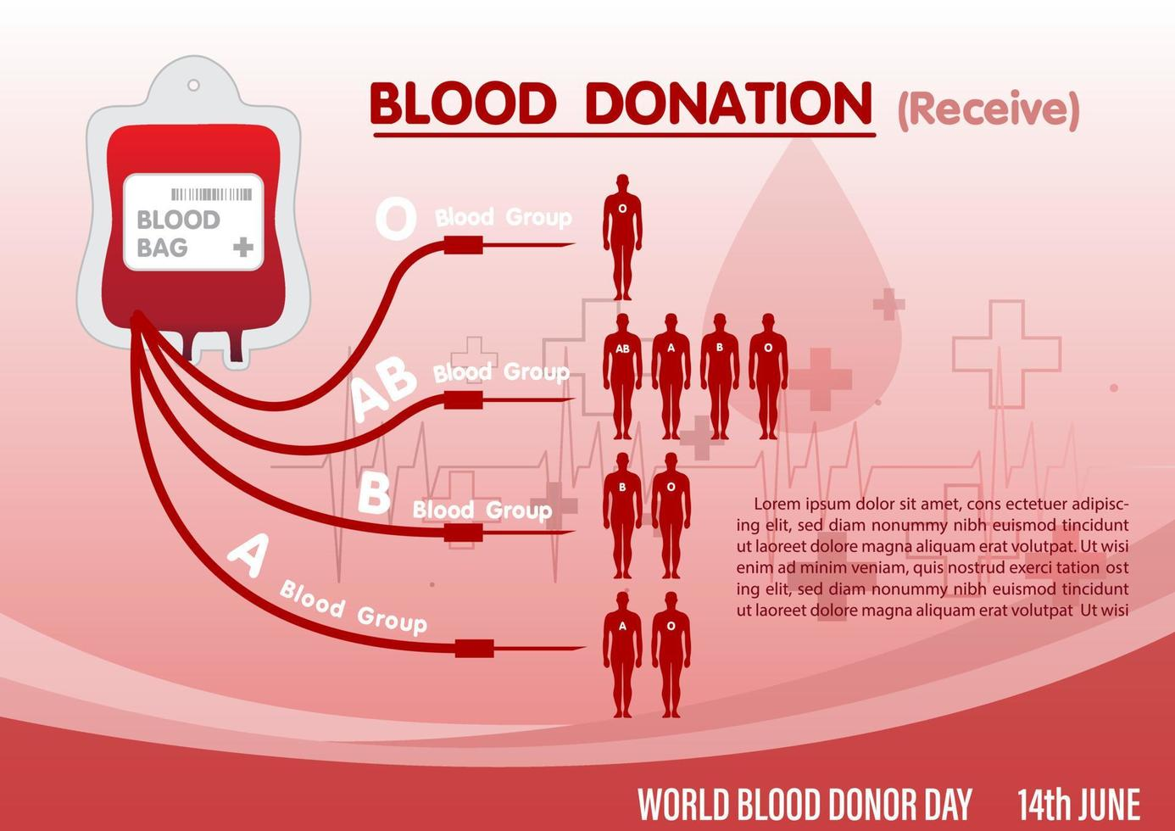
Modules
The system is designed with modularity, allowing for easy customization and future expansion.
1
Donor Registration
Captures donor information, performs eligibility screening, and schedules appointments.
2
Blood Collection
Manages the collection process, labels units, and performs initial testing.
3
Blood Testing
Conducts comprehensive blood testing to ensure safety and compatibility.
4
Inventory Management
Tracks blood units, components, and their availability for distribution.
5
Blood Distribution
Handles requests, prioritizes distribution, and manages transportation.
6
Reporting and Analytics
Generates reports on blood supply, donor trends, and operational efficiency.

Slide 10
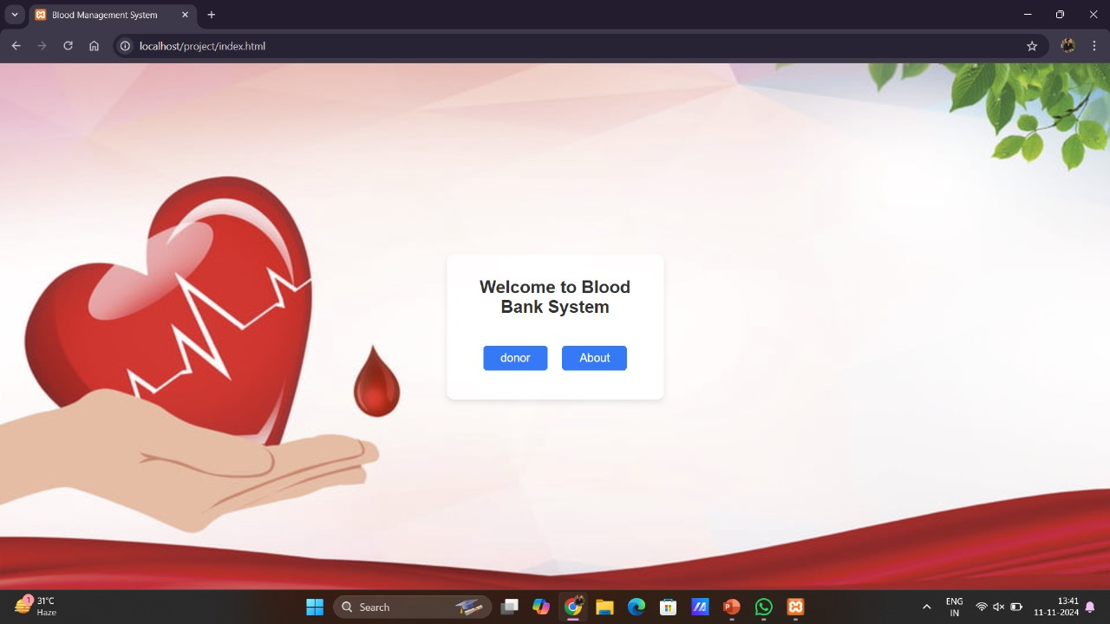
1) Home Page

Slide 11
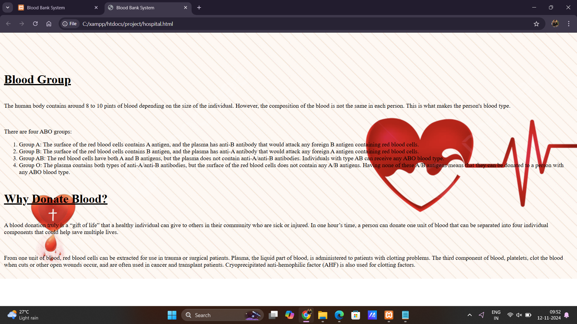
2) About page

Slide 12
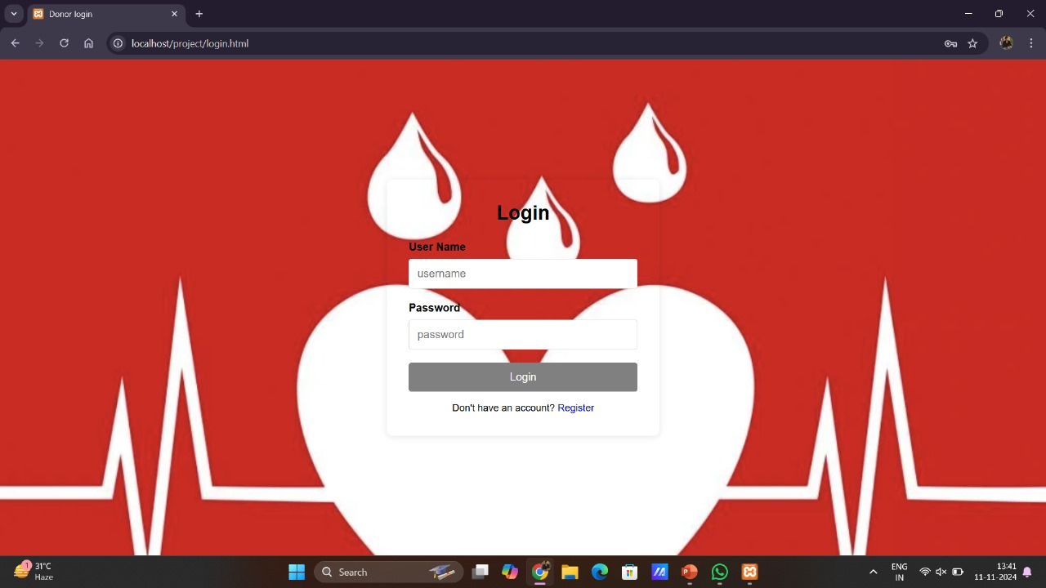
3) Login Page

Slide 13
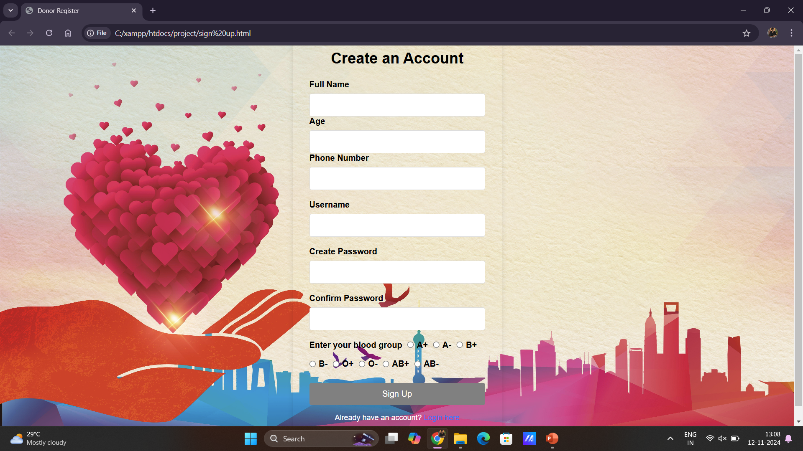
4) Sign-up Page

Slide 14
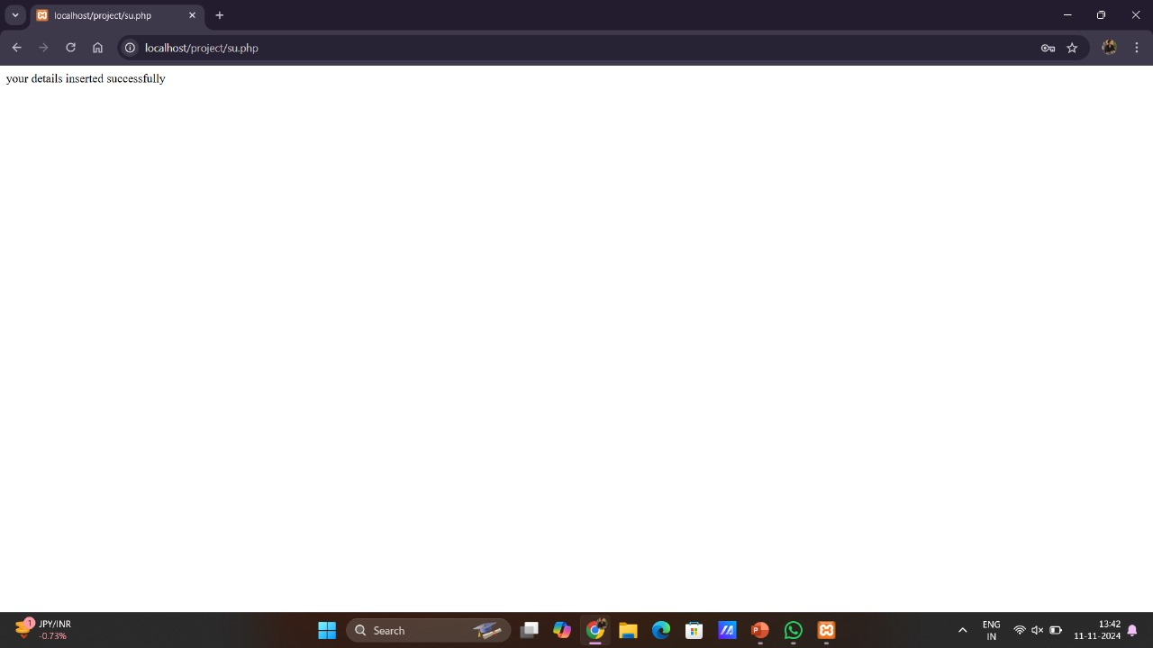
4) Account Created Successfully Page

Slide 15
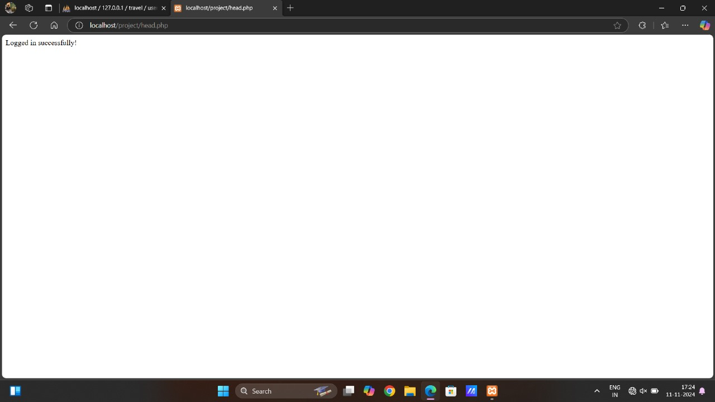
5) Successfully Login Page

Slide 16

Conclusion & Future Enhancements
The proposed blood bank system offers a comprehensive solution to improve blood management, enhance efficiency, and ensure blood safety.
1
Integration
2
Mobile Applications
Integration with hospital information systems to streamline blood ordering and transfusion processes.
Development of mobile applications for donors and hospital staff to facilitate blood donation and management.
3
AI & Machine Learning
Implementation of AI-powered algorithms to predict blood demand and optimize inventory management.

Slide 17


